Slide 1
Extending Embedded System into PL
Zynq
Vivado 2014.2 Version

Slide 2
Objectives
After completing this module, you will be able to:
Identify the IP supplied as part of Vivado
Describe how to add hardware to an existing Vivado project
Explain how IP is added to extend processing system functionality

Slide 3
Outline
IP Catalog
IP directory
IP device files
GP Interfaces
Adding IP to extend PS into PL
Bitstream generation
Summary

Slide 4
The PS and the PL
The Zynq-7000 AP SoC architecture consists of two major sections
PS: Processing system
Dual ARM Cortex-A9 processor based
Multiple peripherals
Hard silicon core
PL: Programmable logic
Shares the same 7 series programmable logic as
Artix™-based devices: Z-7010, Z-7015 and Z-7020 (high-range I/O banks only)
Kintex™-based devices: Z-7030 and Z-7045, and Z-7100 (mix of high-range and high-performance I/O banks)
This sections focuses on the PL

Slide 5
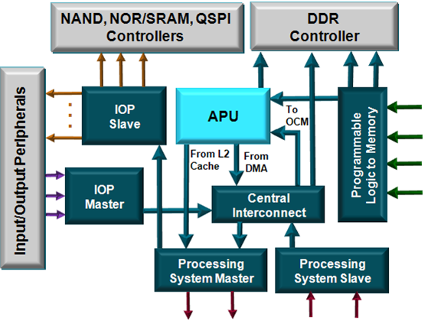
Communicating with PL
Processing system master
Two ports from the processing system to programmable logic
Connects the CPU block to common peripherals through the central interconnect
Processing system slave
Two ports from programmable logic to the processing system
Slave PL peripherals address range
4000_0000 and 7FFF_FFFF (connected to GP0) and
8000_0000 and BFFF_FFFF (connected to GP1)
GP0 GP1

Slide 6
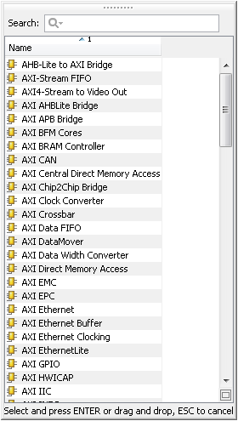
IP Catalog
The IP Catalog contain a collection of IP that can be used to assemble the (embedded) system
Supported by IPI
Facilitates quick system construction
Each IP block has its own configuration parameters
Most of the IP is free, some require licenses
Stored as source code in the install directory
Always synthesized with the latest tools
Some proprietary source code is encrypted
Peripherals in the PS are always present and can be dynamically enabled or disabled through PS Configuration wizard

Slide 7
IP Peripherals Included as Source (Free)
Bus and bridge controllers
AXI to AXI connector
Local Memory Bus (LMB)
AXI Chip to Chip
AHB-Lite to AXI
AXI4-Lite to APB
AXI4 to AHB-Lite
Debug cores
Integrated Logic Analyzer
DMA and Timers
Watchdog, fixed interval
Inter-processor communication
External peripheral controller Memory and memory controller
High-speed and low-speed communication peripherals
AXI 10/100 Ethernet MAC controller
Hard-core tri-mode Ethernet MAC
AXI IIC
AXI SPI
AXI UART
Other cores
System monitor
Xilinx Analog-to-Digital Converter (XADC)
Clock generator, System reset module
interrupt controller
Traffic Generator, Performance monitor

Slide 8
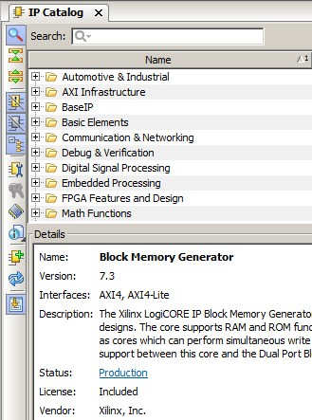
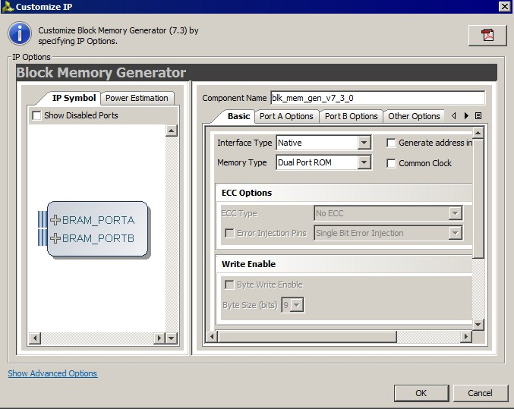
Vivado IP Catalog
Integrated IP Support
Instant access to IP customization
Vivado IP GUI look and feel
Support for Vivado synthesis and implementation
Selectable IP output products
Full Tcl support
Notes:
Vivado has a unified IP catalog – all IP available in one place. The catalog can be extended through use of additional repositories. IP can be selected in the catalog and customization GUIs launched. IP is then added directly to a Vivado project, or in the case of IP Integrator, added to the diagram. The user can select simulation or implementation files. IP can be accessed and customized entirely from the Tcl console as well.

Slide 9
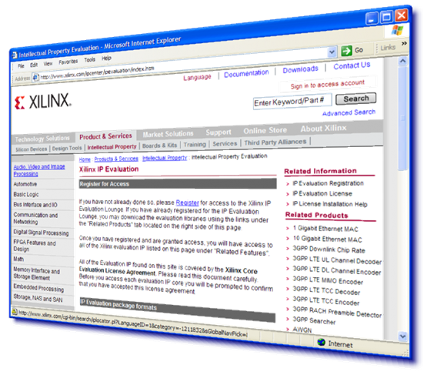
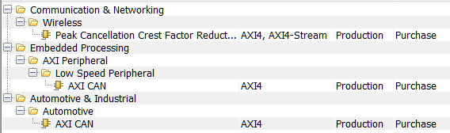
IP Cores Included as Evaluation
AXI CAN controller
AXI USB2 device
Video IP
Telecoms/ Wireless IP
Xilinx developed, delivered, and supported
Evaluation IP installs with a 90-day evaluation license

Slide 10
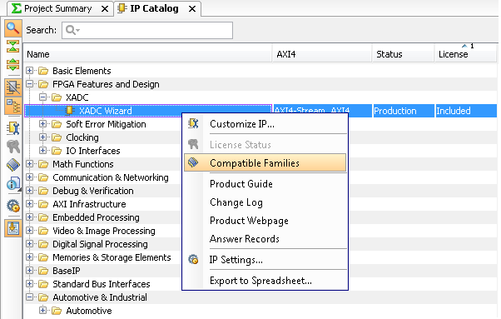
IP Cores
Right click to -
Add/customize
Determine compatibility
Product Guide (datasheet) > Document Navigator
Change Log
Product Webpage
Answer record
Export complete IP Catalog to excel

Slide 11
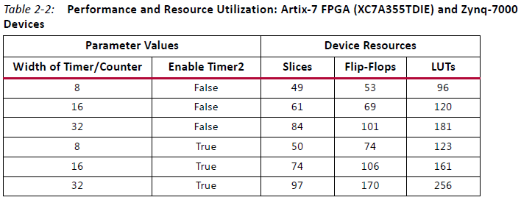
IP Core Information
Data sheet provided for each core (right-click on core in IP catalog to access)
The size of each core is available in the data sheet
For example, the axi_timer_v2_00_a data sheet contains the following table:

Slide 12
Outline
IP Catalog
IP directory
IP device files
GP Interfaces
Adding IP to extend PS into PL
Bitstream generation
Summary

Slide 13
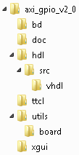
Peripheral Storage
User peripherals can be located in the project directory or a peripheral repository
IP Core directory (located in the project directory)
{component}.xml
MyProcessorIPLib directory (user defined)
Repository Directory listed using Project → Project Options → Device and Repository Search tab
%XILINX_INSTALL%\Vivado\2014.X\data\ip

Slide 14
Outline
IP Catalog
IP directory
IP device files
GP Interfaces
Adding IP to extend PS into PL
Bitstream generation
Summary

Slide 15
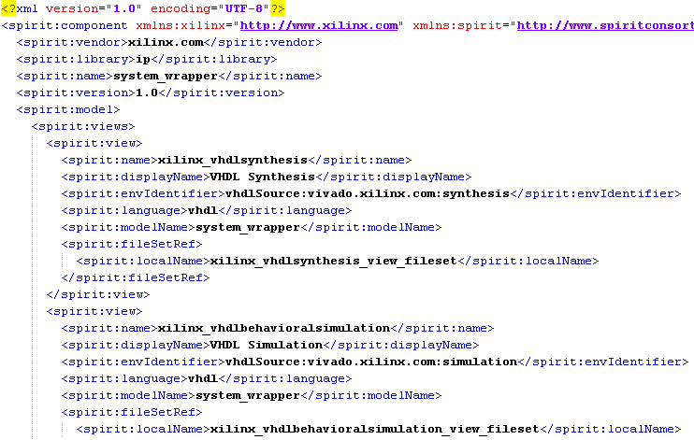
IP Core files
component.xml
XML format
Top level folder
Provides ports description, parameters and options for IP
Links to source files
xgui folder
.tcl file for IPI GUI

Slide 16
Outline
IP Catalog
IP directory
IP device files
GP Interfaces
Adding IP to extend PS into PL
Bitstream generation
Summary

Slide 17

GP Ports
By default, GP Slave and Master ports are disabled
Enable GP Master and/or Slave ports depending on whether a slave or a master peripheral is going to be added in PL
axi_interconnect block is required to connect IP to a port with different protocols
Automatically convert Protocols
Can be automatically added when using Block Automation in IPI

Slide 18
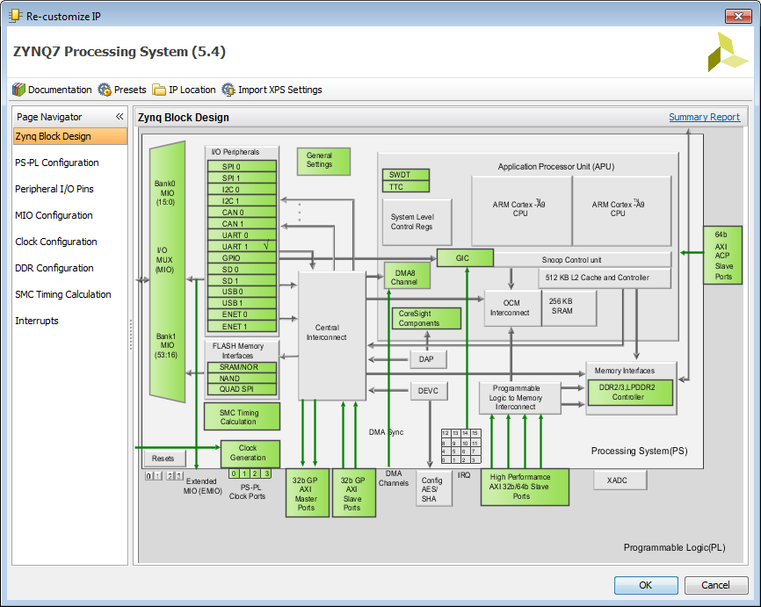
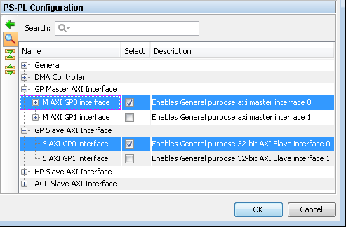
Configuring GP Ports
Click on the menu or green GP Blocks to configure

Slide 19
Outline
IP Catalog
IP directory
IP device files
GP Interfaces
Adding IP to extend PS into PL
Bitstream generation
Summary

Slide 20
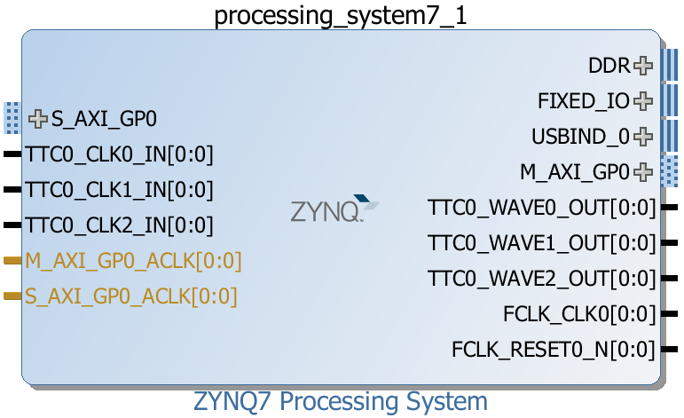

Add IP in the PL
Configure GP ports from PS Customization GUI
PS-PL Configuration
E.g. Enable M_AXI_GP0/1 or S_AXI_GP0/1
Ports will then be available on Zynq Block Diagram
Connect the added IP to the appropriate port
Assign address to the added IP, if unmapped
Configure the IP, if necessary
Make external connections, if needed
Add external ports/interfaces if the added IP is interacting with external devices

Slide 21
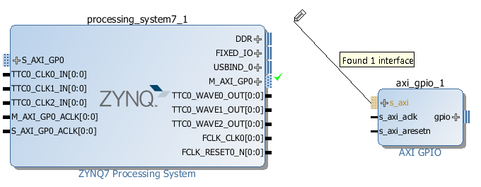
Connecting IP
Add IP from the IP Catalog
Click and drag to find connections
Valid connections Highlighted
Designer Assistance, Connection automation
If Board Support available, IP can be connected to external pins
Or manually create and connect (external) ports

Slide 22
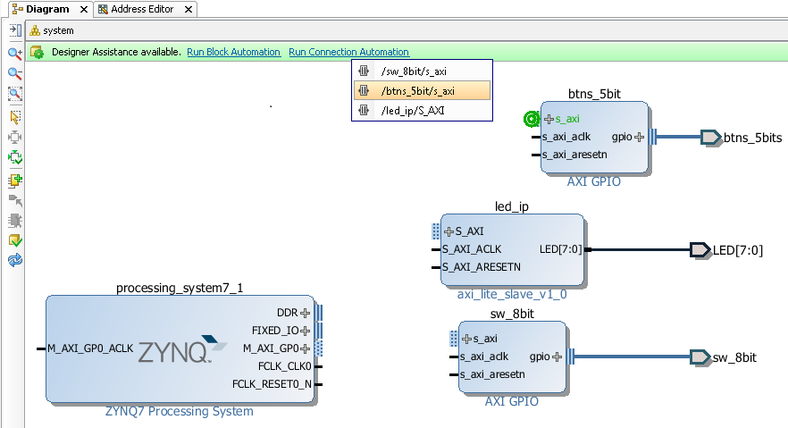
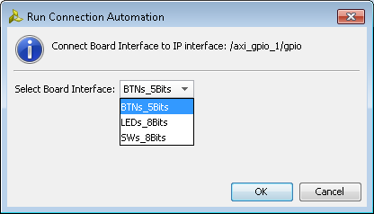
Designer assistance; Block Automation, Connection Automation
Block, Connection
Can automatically connect IP blocks
Automatically insert required blocks
E.g. Add BRAM; Automation will insert and connect BRAM controller and Reset logic
If Board Support is available, IP can automatically be connected to top level ports

Slide 23
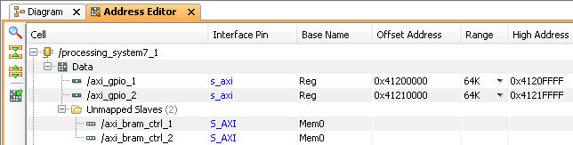
Assign Addresses
Peripherals in the Zynq™ AP SoC PS have fixed addresses and do not appear in the address map when an IP is added to the system
For PS peripherals Click on the Auto Assign Addresses button
The address will be generated and show the generated addresses of the added IP
The fixed addresses of the configured peripherals of the PS

Slide 24
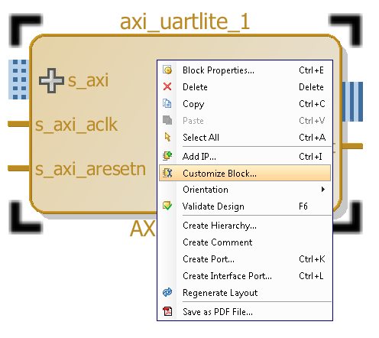
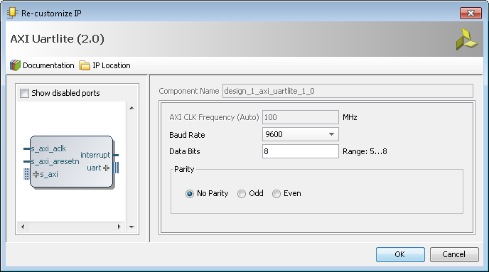
Parameterize IP Instances
Double-click or right click the instance and select Customize Block to open the configurable parameters dialog box (refer to the datasheet if needed)
Default values are shown
Customize the parameters that you want

Slide 25
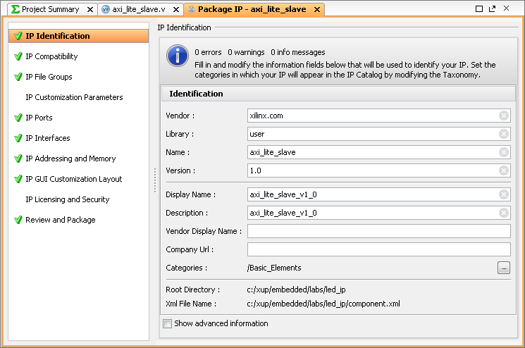
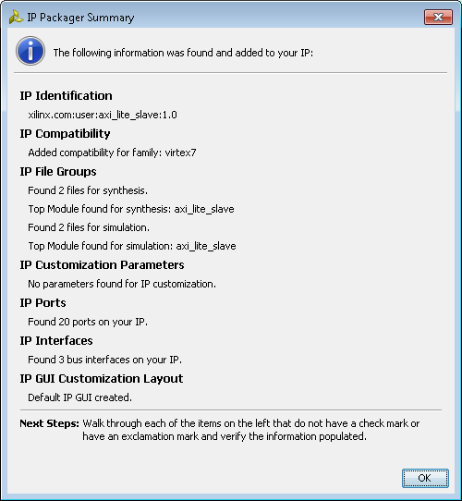
Extending the System
Import custom IP
IP Packager
Packages into IP Integrator Format
Specify repository (local/global)
IP can then be used in IP Integrator
More on IP Packager later

Slide 26
Outline
IP Catalog
IP directory
IP device files
GP Interfaces
Adding IP to extend PS into PL
Bitstream generation
Summary

Slide 27
Bitstream Generation
After defining the system hardware, the next step is to create hardware netlists if the system hardware has logic in PL
A HDL wrapper for the block diagram must be generated
Additional logic can be added to the HDL, or the Processor system can be used as a sub block in a HDL design
The design and block diagram must be open before synthesise and implementation can be carried out
If the system contains hardware in the PL, the bitstream must be generated
The PL (FPGA) must be programmed before application can be downloaded and executed

Slide 28
Outline
IP Catalog
IP directory
IP device files
GP Interfaces
Adding IP to extend PS into PL
Bitstream generation
Summary

Slide 29
Summary
PS functionality can be extended by instantiating peripherals in PL
Adding IP in PL involves
Enabling interface(s) in PS
Selecting IP from the IP Catalog and configuring IP for desired functionality
Connecting the (PL) IP to the PS using IP Integrator
Assigning address
Connecting IP ports to ports of other peripherals and/or to external pins
HDL Wrapper is needed for IP Integrator Block
Bitstream must be generated when PL has any IP
The FPGA must be programmed with the generated hardware bitstream before an application can be run

